Slide 1
2022
FACT / KEY / ISA
Outcomes Evaluation
Polk County Region Governing Board
August 22, 2022

Slide 2
FACT Overall Program Performance
88% - 100% Exceeds Expectations
75% - 87% Meets Expectations
63% - 74% Needs Improvement
Below 63% Does Not Meet Minimum Expectations

Slide 3
FACT Results Overview
FACT Program performance in the Involvement in the Criminal Justice System outcome has shown steady improvement.
Over the past 5 years, participant nights spent in jail gradually decreased by 11.23 nights on average, shifting from Meeting Expectations in 2018-2019 to Exceeding Expectations from 2020-2022.
Along with medication management and staff availability outside of regular business hours, FACT staff attributes success in reducing recidivism to using a strengths based approach with participants, which includes acknowledging and celebrating achievements in the community, positive affirmations, and unconditional encouragement.

Slide 4
FACT Results Overview
FACT performance in employment outcomes was lower in 2022, compared to previous years.
While the Working Toward Self Sufficiency outcome (left chart) still received an Exceeds Expectations rating in 2022, performance decreased by 23% from 2021.
While the Engaged in Employment outcome (right) still received a Meets Expectations rating in 2022, performance decreased by 49% from 2021 (an exceptionally high performing year).
Staff reported performance in employment outcomes was affected by participant motivation to work (including reservations about how income might impact benefits and program eligibility and transitioning back to work post-pandemic), employer rigidity in screening out applicants with histories involvement in the criminal justice system (especially if charges related to substance use), limited options for reliable transportation options to work, and participant averseness to working in available food service jobs.

Slide 5
FACT Results Overview
Overall, FACT performance across the 16 outcome areas varied, with 8 outcomes Exceeding Expectations and 3 outcomes Not Meeting Minimum Expectations.
Notably, 5 areas - Housing, Emergency Rooms Visits for Psychiatric Care, Participant Satisfaction, Community Inclusion, and Working Toward Self-Sufficiency - have maintained Exceeds Expectations ratings over the last 5 years throughout challenging circumstances. Quality of Life and Administrative Outcomes have Exceeded Expectations over the last 4 years.
FACT program participants report receiving high quality services which meet their needs and improve their lives. Participants describe staff as supportive, responsive, knowledgeable, and respectful.
“Tell them, ‘thank you very much’ for helping me. I respect this program. I got in this program when I was in prison…I got in the program and haven't been back [to prison].”
“Before I was just stuck in my apartment… I didn't go outside. Now they give me the momentum to go out and do things.”

Slide 6
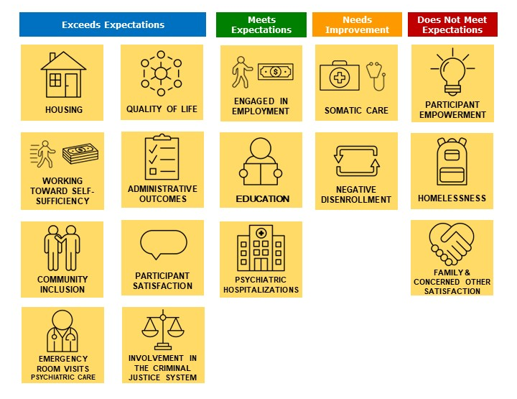
FACT Outcomes by Performance

Slide 7
KEY Overall Program Performance
88% - 100% Exceeds Expectations
75% - 87% Meets Expectations
63% - 74% Needs Improvement
Below 63% Does Not Meet Minimum Expectations

Slide 8
KEY Results Overview
KEY Program performance in four outcome areas (Education, Somatic Care, Community Inclusion, and Participant Empowerment) was negatively impacted by the pandemic in 2020.
Performance in all four outcome areas show steady improvements over the last two years.
Compared to 2020, the Education and Somatic Care outcomes both increased by 13%,
the Community Inclusion outcome increased by 30%,
and the Participant Empowerment outcome increased by 54%.

Slide 9
KEY Results Overview
KEY program performance in the Involvement in the Criminal Justice System outcome increased notably, moving from the Exceeds Expectations category in 2021 to Does Not Meet Minimum Expectations in 2022.
In 2022, the KEY program included three participants who spent 150 or more nights in jail in the reporting period. KEY staff reported that participant time in jail can increase after the original sentence, because some participants receive additional charges while in jail, racial disparities were noted.

Slide 10
KEY Results Overview
KEY Program performance in Housing, Homelessness, Psychiatric Hospitalization, Participant Satisfaction, Participant Quality of Life, Negative Disenrollment, and Administrative Outcomes remains high and stable, with all seven outcomes Exceeding Expectations over the last 5 years throughout challenging circumstances (except the Homelessness performance in 2018).
Overall, KEY staff report intentional and proactive collaborations, and problem-solve with evidence-based solutions. For example, using motivational interviewing, and connecting participants to DMACC’s Workforce Training Academy, Young Adult Program, and Career Fair, as well as Children and Families of Iowa’s Connect to Careers program.
KEY program participants report receiving high quality services which meet their needs and improve their lives. Participants describe staff as supportive, responsive, knowledgeable, and respectful.
“If I need support, they’re there. They went with me to DMACC to help me sign up for college. [Staff] helps with everything, one-hundred percent. [Staff] is down to earth and respectful. Even if they don’t know the answer, they will find it. If they say they're going to follow through they do. And they are always communicating.”
“They [staff] have taught me things I never learned in foster care like apartment living and living on my own.”

Slide 11
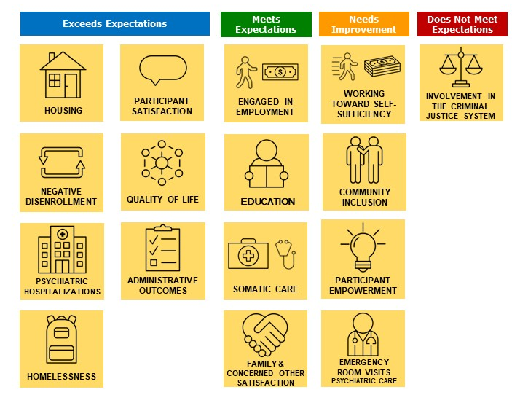
KEY Outcomes by Performance

Slide 12
ISA Overall Program Performance
88% - 100% Exceeds Expectations
75% - 87% Meets Expectations
63% - 74% Needs Improvement
Below 63% Does Not Meet Minimum Expectations
Notes:
4 agencies

Slide 13
ISA Results Overview
Agencies are committed to connecting participants with person-centered and sustainable employment opportunities.
While performance in both employment outcomes (Engaged In Employment outcome shown above) decreased in 2022, the system maintained Meets Expectations ratings. Agency staff acknowledged that participant circumstances and preferences - including transitioning to returning to work post-pandemic, limited transportation options, and reluctance to work in food service – detract from the employment outcome but ensuring a good fit long term is the priority.
Agency staff and participants report collaborative relationships with employers, meaningful jobs, enhanced financial independence, increased efficacy, and improved confidence in interacting with colleagues.

Slide 14
ISA Results Overview
Performance across agencies varied in three outcomes areas.
System performance was split in Community Inclusion (not shown), Involvement in the Criminal Justice System (left) and Homelessness (right). In all three outcome areas, two agencies Exceeded Expectations and two agencies Did Not Meet Minimum Expectations or Need Improvement.
Agencies reported that factors affecting performance included staff capacity, participant referral sources, and agency values.

Slide 15
ISA Results Overview
System performance in Housing, Emergency Rooms Visits for Psychiatric Care, and Participant Satisfaction, remains high and stable, with all three outcomes Exceeding Expectations over the last 5 years throughout challenging circumstances.
Agencies report scarce availability of acceptable housing that meets affordability criteria and acknowledged the benefits of having a specialized Housing Coordinator as a resource for ISA staff and participants.
ISA staff emphasize the importance of trusting relationships in effective crisis de-escalation and employ strategies to prevent ER visits, including routine preventative care, medication management, crisis phone lines, and participant education.
ISA program participants report receiving high quality services which meet their needs and improve their lives. Participants describe staff as supportive, responsive, knowledgeable, and respectful.
“I'm happy that when something bad happens that is out of your control that [staff] have that knowledge and understanding on how to help me.”
“My mental health is a lot more stable than what it was, and I don't feel like I’m on a dead-end road now.”

Slide 16
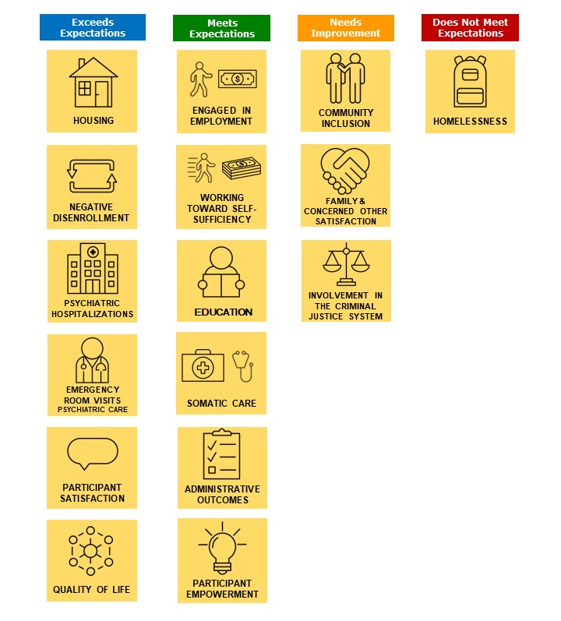
ISA Outcomes by Performance

Slide 17
Questions?
University of Iowa College of Law
Iowa City, Iowa 52242
(319) 335-8469
http://disability.law.uiowa.edu
tessa-heeren@uiowa.edu

